Slide 1


ITW-2 PROJECT by : Vishishta Pakhi 22075093 antim bansal 22075012 GROUP NO. 13

Slide 2


INSTIPRO
InstiPro is a database management app for managing college database. It supports ‘crud’ operations and has a responsive frontend. Some of the features include:
Adding/editing/deleting data of students,staff,subjects,courses etc.
Viewing of the above data.
It has login feature and features like attendance, feedback portal, leave application and notifications.
Technologies used: html, css, Django, javascript, mysql
WEBSITE LOGO

Slide 3
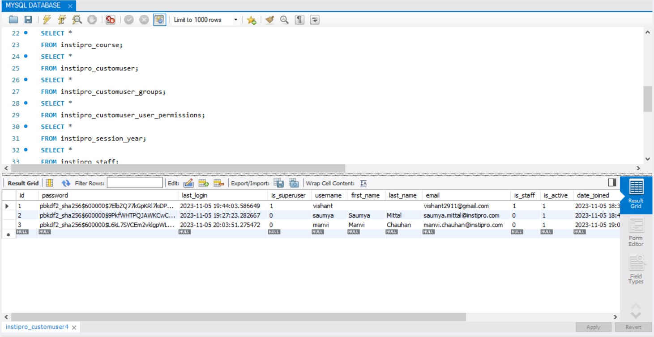
DATABASE

Slide 4
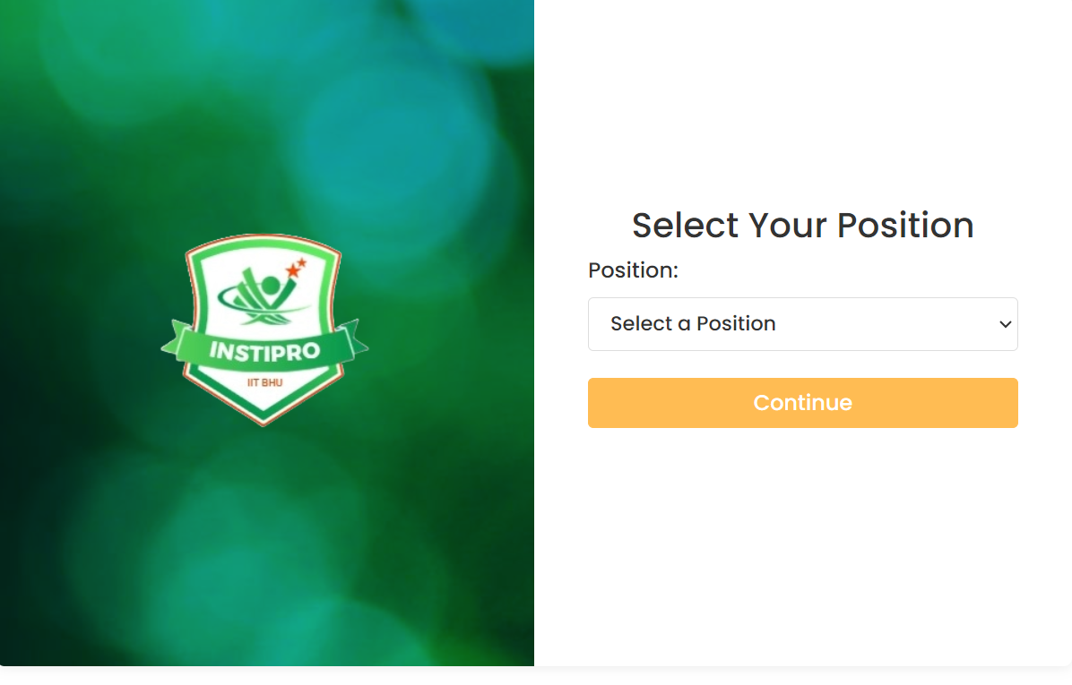
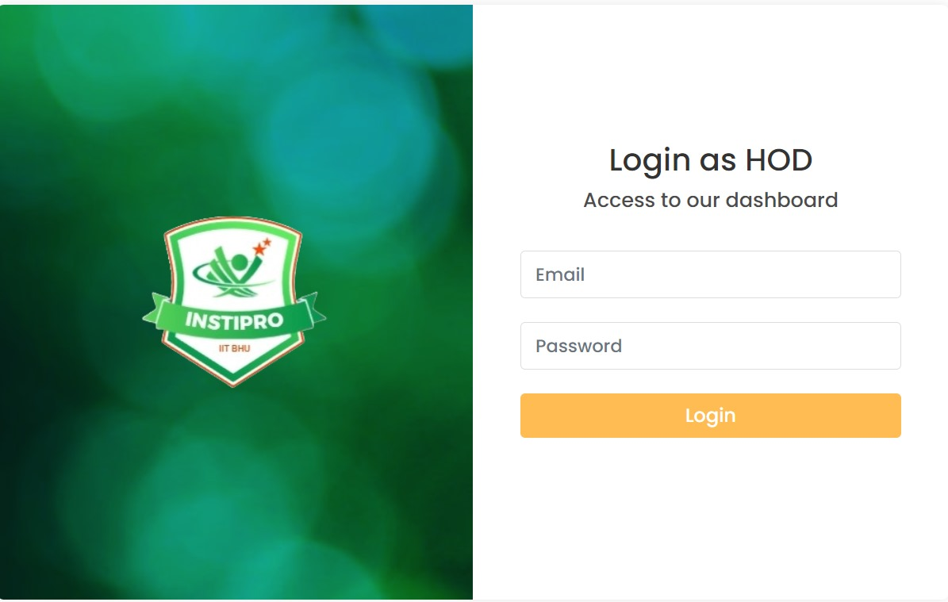
SELECT POSITION & LOGIN PAGE
This is the first page of our site.
Here, user first selects position[student, staff, hod] and then the login page opens for same and they shall fill their details. The login button directs to dashboard of respective user.

Slide 5
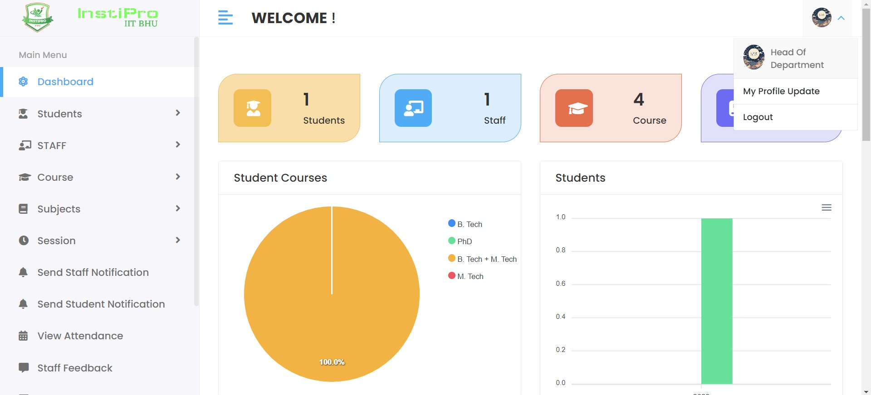
DASHBOARD
THIS IS THE FRONT PAGE OF HOD DASHBOARD.
IT INCLUDES FEATURES AS APPLY FOR LEAVE , NOTIFICATIONS , FEEDBACK , ATTENDANCE AND ABOUT STUDENTS AND STAFF AND ALSO IT HAS A FEATURE FOR LOGOUT .
IT ALSO CONTAINS THE PIE CHARTS AND BAR CHART OF SOME INFORMATION OF STUDENTS AND STAFF INFORMATION AND ON THE UPPER RIGHT SIDE IT HAS A OPTION FOR UPDATE THE PROFILE ETC...

Slide 6
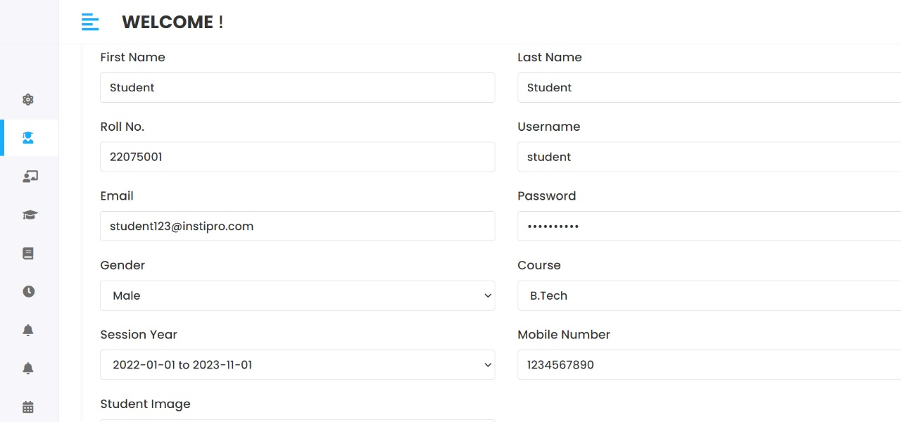
ADD PAGE
1 . Form for Adding Details: Users can input essential information, including first name, last name, roll number, contact details, and more.
2 . Dropdown Selections: Users can select gender, course, and session year from predefined options in dropdown menus.
3 . Saving the form: The form is submitted and details filled including names, mobile numbers, and address are saved in admin site. only hod can perform these functions.

Slide 7
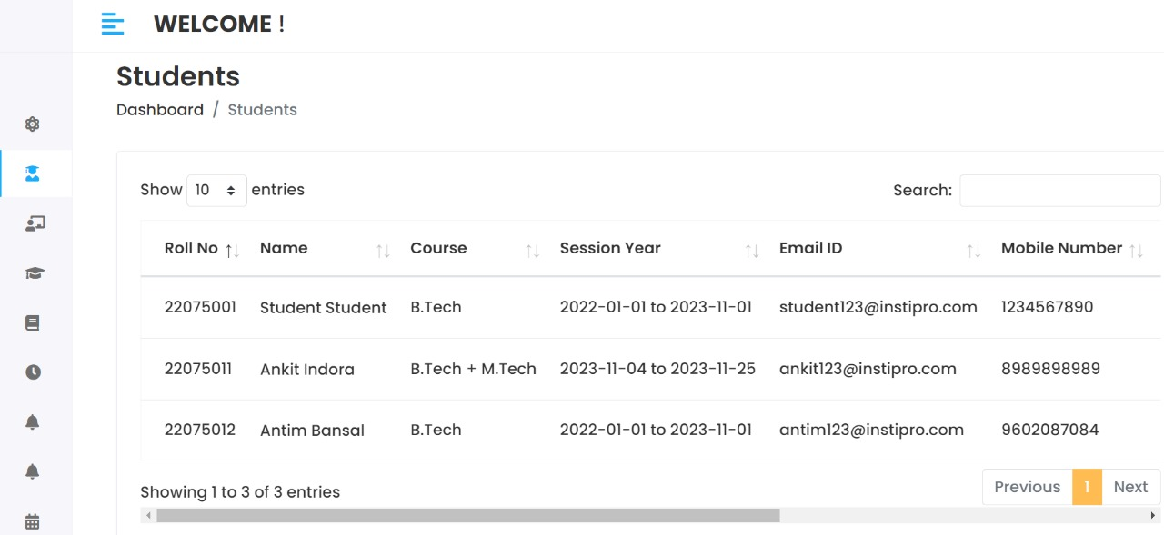
VIEW PAGE
This is a view page.
Here the entered information about various things[student, staff, subject etc.] is shown in a table like format.
There is also an action button for each row to edit or delete the specific tupple.

Slide 8
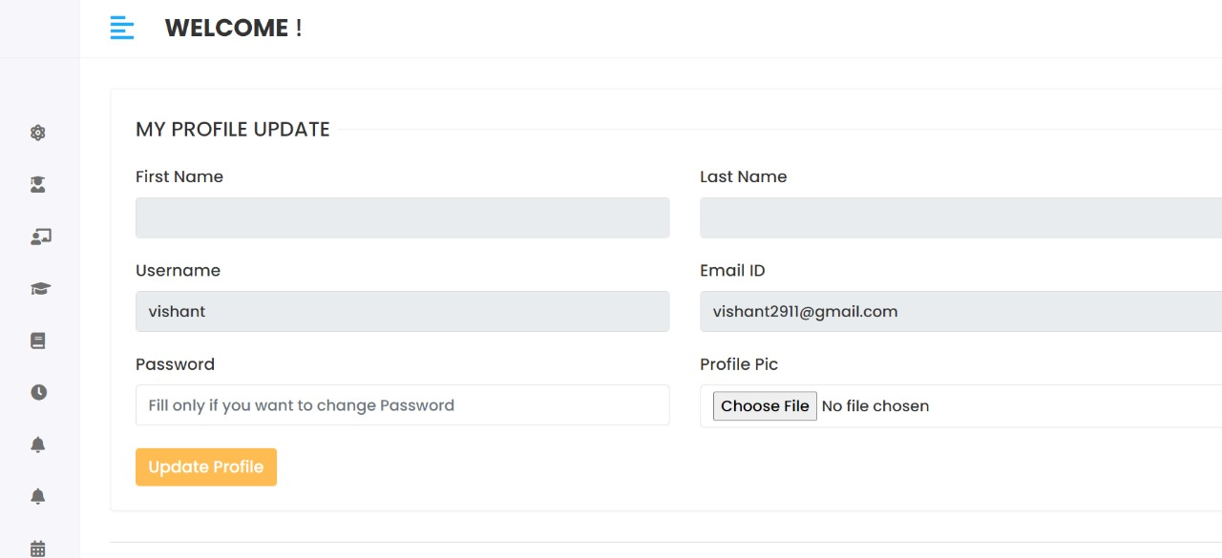
PROFILE UPDATE
This is profile updation page where user can update there profile pic and password.
It is opened by clicking the profile picture icon on dashboard upper right corner.

Slide 9
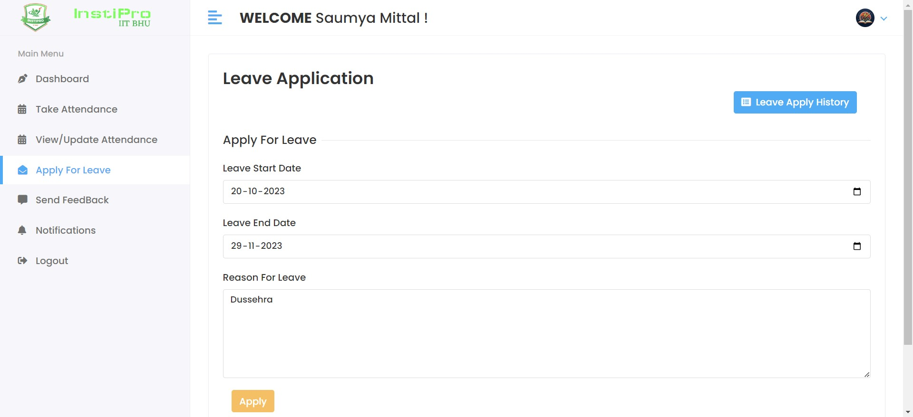
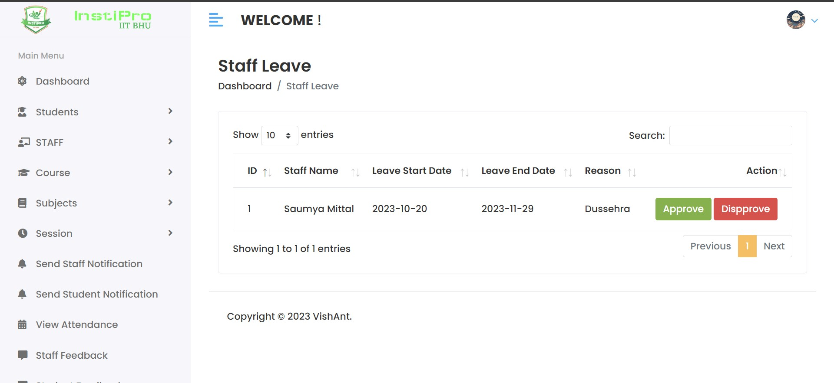
Apply leave & ACCEPT LEAVE
THIS IS THE APPLY PAGE OF OUR SITE .
HERE STAFF OR STUDENT CAN APPLY FOR LEAVE AND THE HOD CAN ACCEPT OR REJECT THEIR LEAVE PROPOSAL .

Slide 10
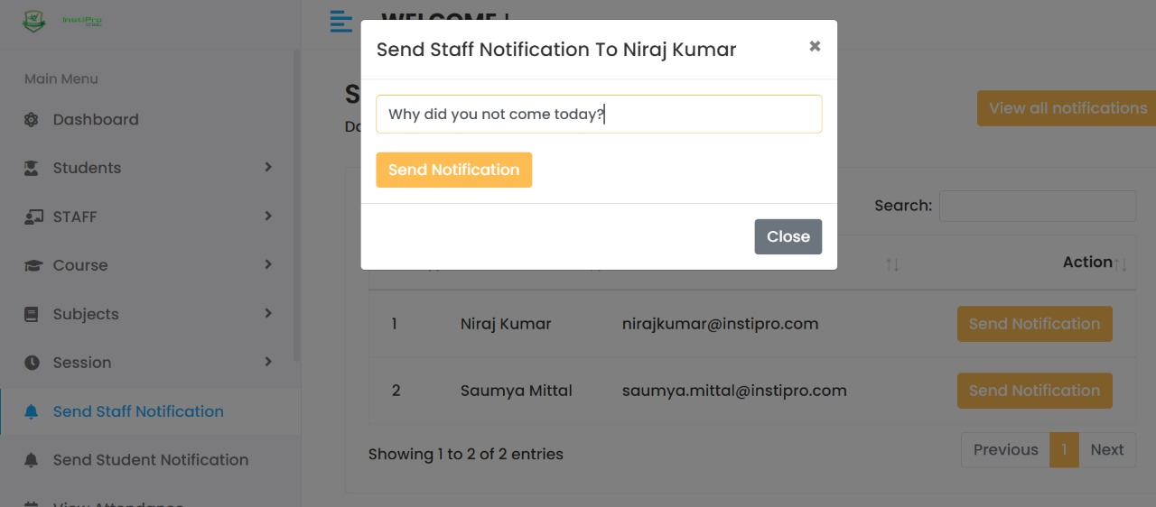
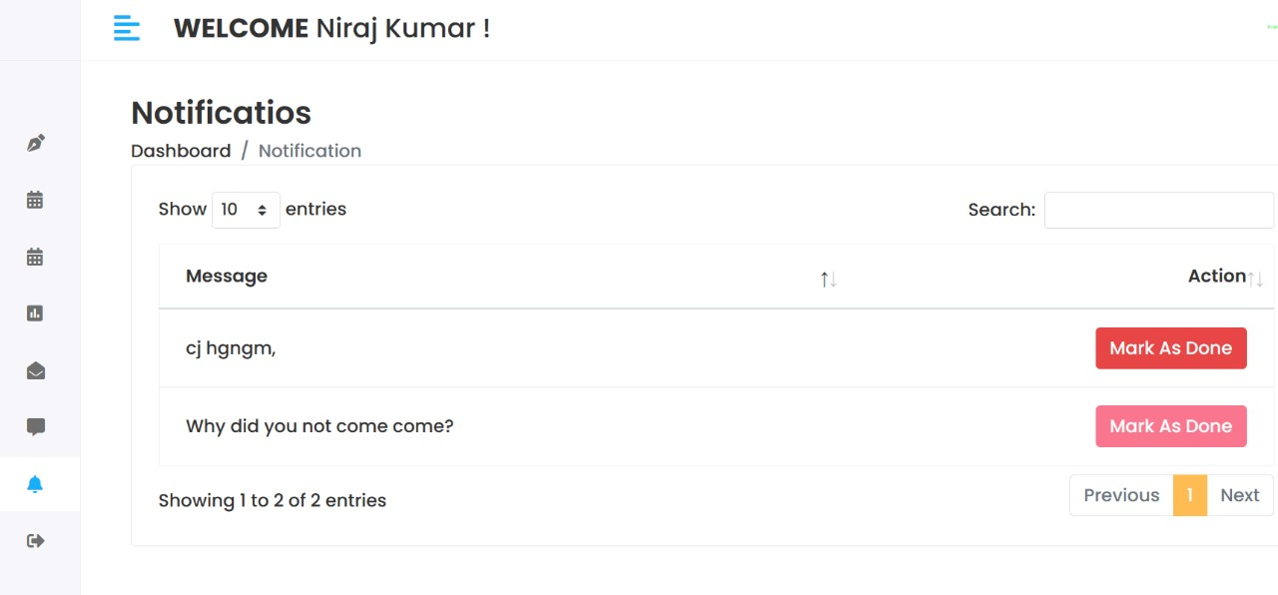
NOTIFICATION SEND AND READ
THIS IS THE NOTIFICATION PAGE OF OUR SITE .
HERE THE HOD CAN SEND THE NOTIFICATION TO STUDENT OR STAFF .
AND STAFF OR STUDENT CAN READ THE NOTIFICATION AND REPLY TO THE HOD . AND HOD CAN SEE THEIR REPLY .

Slide 11
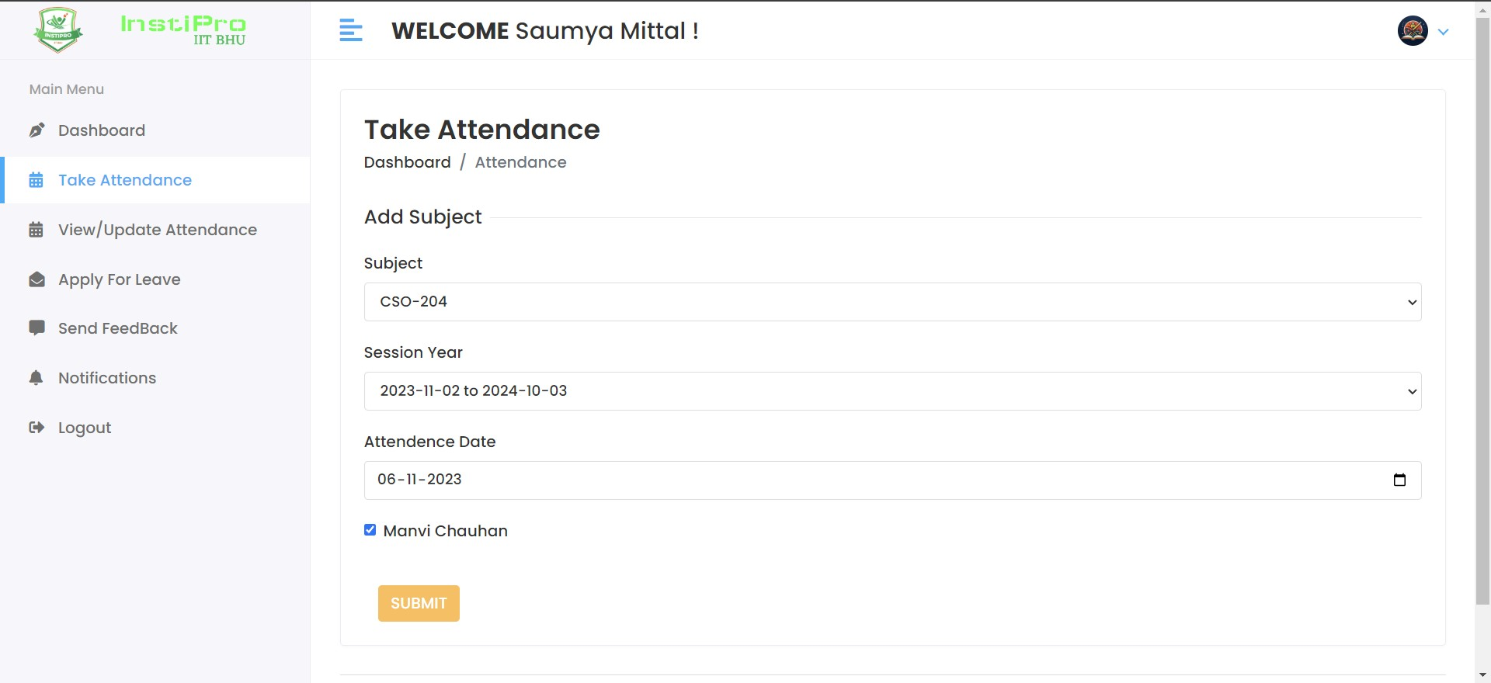
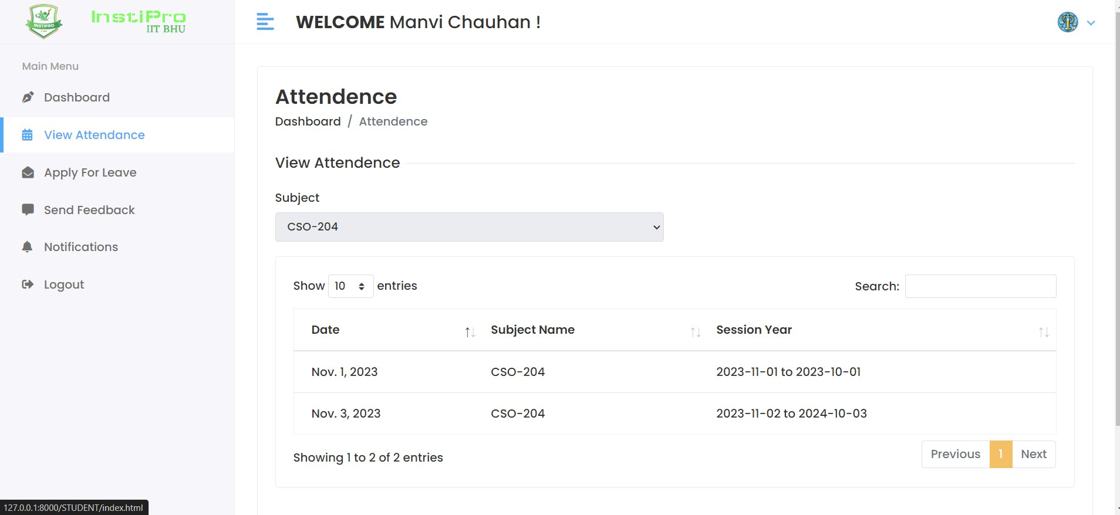
ATTENDANCE – TAKE AND VIEW
This is the attendance page of our site.
Here the teacher can take attendance of students and students can view their attendance .
Hod can also view the students attendance.

Slide 12
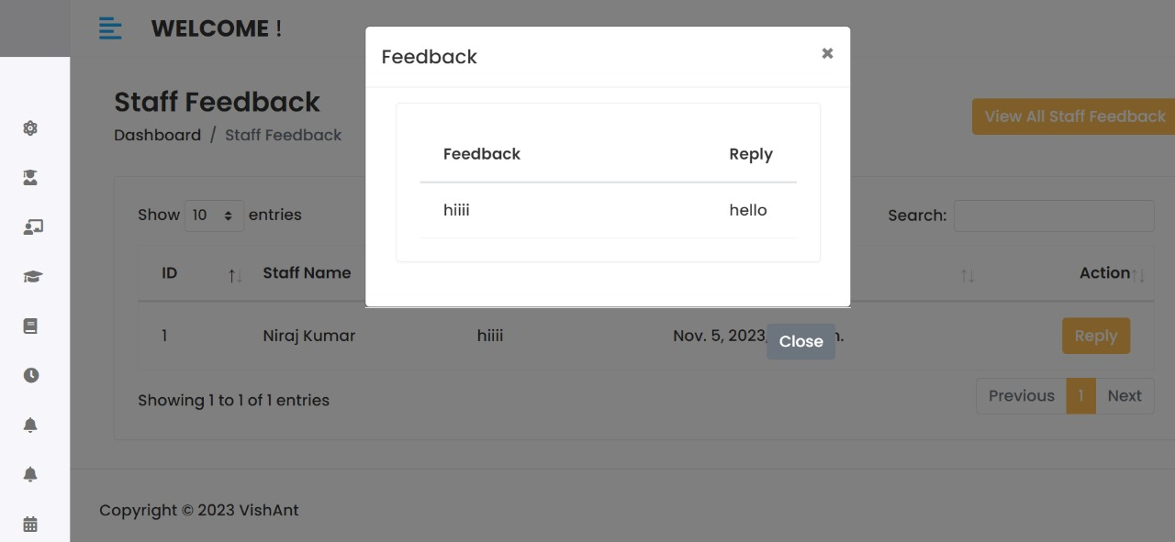
Feedback portal
Here students and staff can give there feedback to hod and hod can reply to them.

Slide 13
Thank You
Vishishta.Pakhi.cse22@itbhu.ac.in
Antim.bansal.cse22@itbhu.ac.in

